Slide 1
Computer Architecture Lab1

Slide 2
Mark Distribution
Final Examination Weighting: 60%
Course Work Weighting: 40%
Assessment 1: 20%
Assessment 2: 20%
Notes:
Main components of the computer,
ALU is responsible for the Arithmetic operations (add, sub, ..)
Control tells Memory, I/O, and ALU what to do according to the instructions of the program.

Slide 3
Assessments Deadline
Assessment 1: Week 8
Assessment 2: Week 11
Notes:
Main components of the computer,
ALU is responsible for the Arithmetic operations (add, sub, ..)
Control tells Memory, I/O, and ALU what to do according to the instructions of the program.

Slide 4
Computer Architecture
Computer architecture is a specification detailing how a set of software and hardware technology standards interact to form a computer system or platform.
In short, computer architecture refers to how a computer system is designed and what technologies it is compatible with.
Notes:
Main components of the computer,
ALU is responsible for the Arithmetic operations (add, sub, ..)
Control tells Memory, I/O, and ALU what to do according to the instructions of the program.

Slide 5
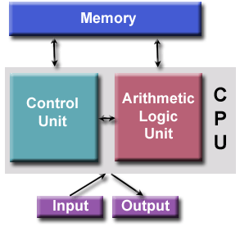
Basic Computer Architecture Von Neumann Architecture
Notes:
Main components of the computer,
ALU is responsible for the Arithmetic operations (add, sub, ..)
Control tells Memory, I/O, and ALU what to do according to the instructions of the program.

Slide 6
Registers
A special, high-speed temporarily storage area within the CPU.
All data must be represented in a register before it can be processed.
For example, if two numbers are to be added, both numbers must be in registers, and the result is also placed in a register.
Size of Registers: holds one word size
Notes:
Main components of the computer,
ALU is responsible for the Arithmetic operations (add, sub, ..)
Control tells Memory, I/O, and ALU what to do according to the instructions of the program.

Slide 7
Control Signals to Registers
Increment (INC or INR):
Increments the value inside the register.
Load (LD):
Loads a new value inside the register.
Clear (CLR):
Clears the value inside the register to be zero.
Notes:
Main components of the computer,
ALU is responsible for the Arithmetic operations (add, sub, ..)
Control tells Memory, I/O, and ALU what to do according to the instructions of the program.

Slide 8
Memory
Memory is an array of information units
Each unit has the same size
Each unit has its own address
Address of an unit and contents of the unit at that address are different.
0 | 70
1 | 80
2 | 50
3 | 40
4 | 100
5 | 90
Address
Content

Slide 9
Memory
Memory Address:
A number that is assigned to each cell in a computer memory.
Address lines:
The number of bits to represent memory address.
Data lines:
The number of bits to represent the data in each memory address.
Notes:
Main components of the computer,
ALU is responsible for the Arithmetic operations (add, sub, ..)
Control tells Memory, I/O, and ALU what to do according to the instructions of the program.

Slide 10
Control Signals to MemoRy
Memory Read:
Makes the data from an Addressed Location to be Placed on the Data Bus, to be Read by the CPU.
Memory Write:
Makes the data on the Data Bus to be written into the Addressed Location in the memory.
Notes:
Main components of the computer,
ALU is responsible for the Arithmetic operations (add, sub, ..)
Control tells Memory, I/O, and ALU what to do according to the instructions of the program.

Slide 11
Memory
The Memory is described by the number of memory cells times the number of bits per memory cell.
For example, how many address lines and data lines are there in the following memory unit.
64Kw ×8
Address lines = 16 lines
Data Lines = 8 lines

Slide 12
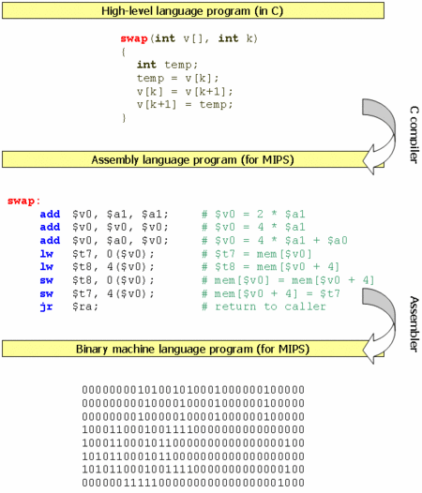

Slide 13
Assembly Language
High Level Programming Langugae
A=B+C
Assembly Language
add R0,R1,R2
Value of B is stored in R1
and value of C is stored in R2
and the result will be stored in R0.
Notes:
Instruction set architecture (ISA) is the interface between the software and hardware. Computers do not understand high level languages. A processor only understand instructions encoded as binary numbers.

